Slide 1

Comparative Knowledge Based System for Detecting Breast Cancer
Classification Using Fuzzy Logic Method.
Supervised By: | Presented By:
Dr. Mir Md. Jahangir Kabir Professor Department of Computer Science & Engineering Rajshahi University of Engineering and Technology | Ansar Uddin Emon Roll: 1503049 Department of Computer Science & Engineering Rajshahi University of Engineering and Technology

Slide 2
1
Knowledge Based System
Predict any value/situations
A learned system
An intelligent system
Optimization of a very large dataset
YES
95%
Knowledge
based
system
Possibility
Of Rain

Slide 3

2
How to build?
Combination of
Clustering algorithms
Reduction techniques
Decision Tree
Fuzzy rules
EM Algorithm
Between
1 and 0
PCA
(Principal Component Analysis)
CART
(Classification
&
Regression
Trees)
KNN
SVM
K-Means

Slide 4
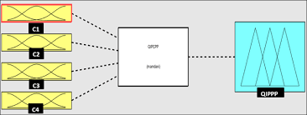
3
Breast Cancer Dataset
Data Preprocessing(1)
Clustering Using EM (2)
PCA (3)
CART (4)
Fuzzy
Rule
Based(5)
Principle rule base
Breast
Cancer
Diagnosis
Fuzzy
Inference

Slide 5
4
Dataset
Wisconsin Diagnostic Breast Cancer (WDBC)
WDBC was taken from the University of Wisconsin
It contains 569 instances.
There are ten real value attributes.
The class attribute is benign or malignant.

Slide 6
5
BREAST CANCER DETECTION
Related Works with this dataset:
C4.5 decision tree,Quinlan (1996)
Neuro-fuzzy techniques, Nauck and Kruse (1999)
k-nearest neighbor, Şahan (2007)
EM+PCA+CART+Fuzzy Logic, Nilashi(2017)

Slide 7
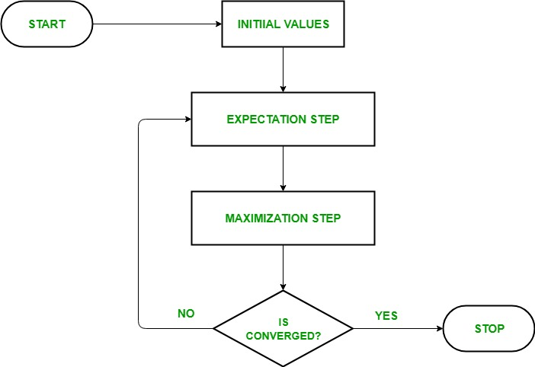
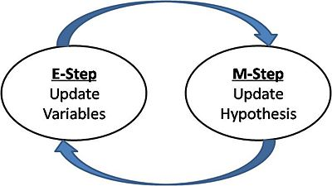
6
EM(Expectation Maximization) Algorithm
It is always guaranteed that likelihood
will increase with each iteration.

Slide 8
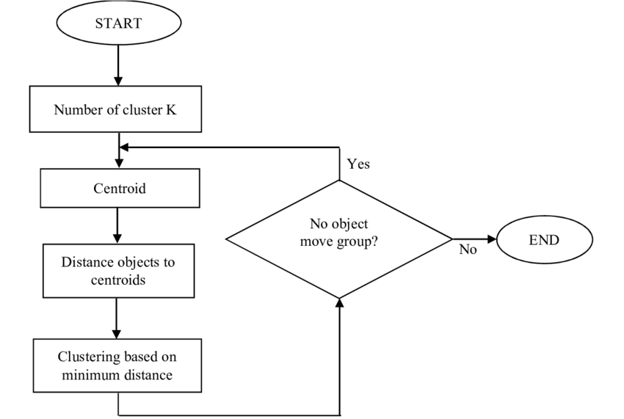
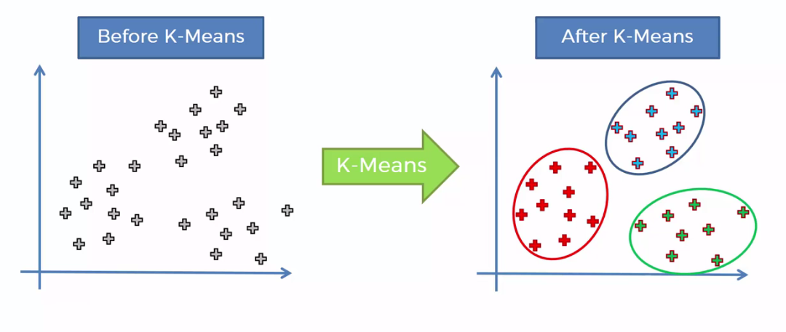
7
K-Means Clustering Algorithm

Slide 9
8
PCA(Principal Component Analysis)
Feature Extraction
Dimensionality reduction technique to address the multicollinearity issue
Lossy data compression
CART(Classification & Regression Trees)
To generate the fuzzy rules from the data

Slide 10

9

Slide 11
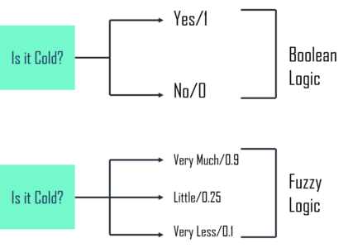
10
Fuzzy Logic

Slide 12
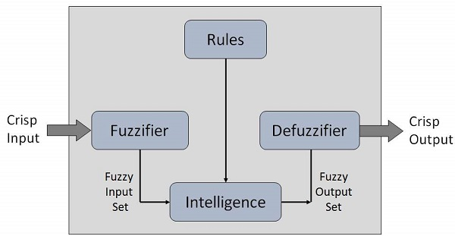
11
Fuzzy Logic System
Tools: Mamdani type of fuzzy method through fuzzy logic toolbox provided in MATLAB software

Slide 13
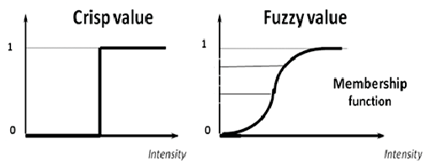
12
Crisp Value & Fuzzy Value

Slide 14
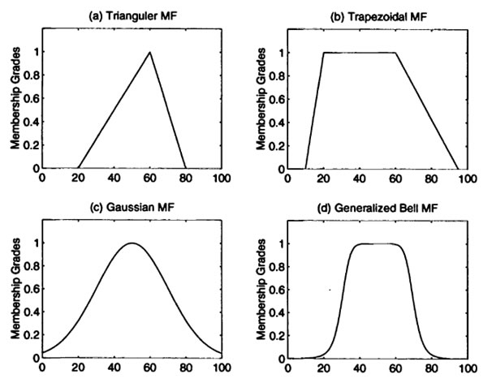
13
Membership Function
Output Defuzzification
Input Fuzzification

Slide 15
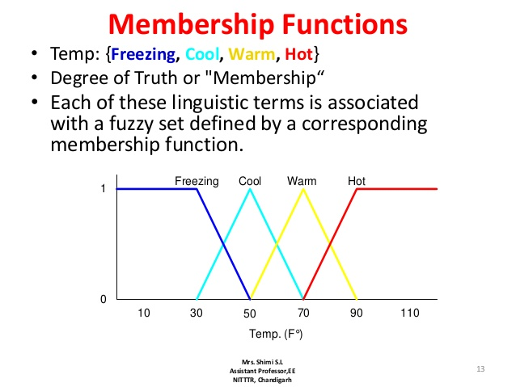
14

Slide 16
15
A published Knowledge Based System:
(Authors: Mehrbakhsh Nilashi, Othman Ibrahim, Hossein Ahmadi Leila Shahmoradi)
EM Algorithm
PCA
CART
0.932 Accuracy
Fuzzy Rule Based
Proposed Knowledge Based System:
K-means Algorithm
PCA
CART
Accuracy=???
Fuzzy Rule Based

Slide 17

Any Question?

